Slide 1

Introduction to QoE and Its Relationship with Usability
Mikołaj Leszczuk, Zdzisław Papir, Lucjan Janowski, Jakub Nawała
Notes:
This is what we are doing on a daily basis.
We say multimedia here, but we mainly work with videos (usually w/o sound). Such a limitation of context necessary because we are dealing with a difficult problem.

Slide 2
Presentation Outline
Multimedia Quality of Experience (QoE)
Subjective Methods of Measuring QoE
Objective Methods for Measuring QoE
Quality of Experience and Its Relationship with Usability

Slide 3
Multimedia Quality of Experience (QoE)

Slide 4

Caring about the perceived quality of multimedia services (Quality of Experience) is essential for service and content providers:
due to competition between providers
in the face of changing ways to use the media.
(graphics: Media Trendy 2008)
Notes:
It is the end-user’s satisfaction that makes your service better than others. The problem is - the demand for quality is constantly rising.

Slide 5

Internet TV, Video on Demand...
Daniel Minoli - „Video Dialtone Technology” 1995
There is now feverish activity in telecommunications, CATV, ISPs to deploy the Information Superhighway...
A key driver of the Information Superhighway is video.
Thomas Miki - ComMag 1994
The battle has begun, and only those carriers who provide the highest level of performance, reliability, and flexibility
will be the winners.
Notes:
Wspomnienie – okres PTK Kraków, projekty BBL oraz BTI (Polska-Dania), Lucent

Slide 6
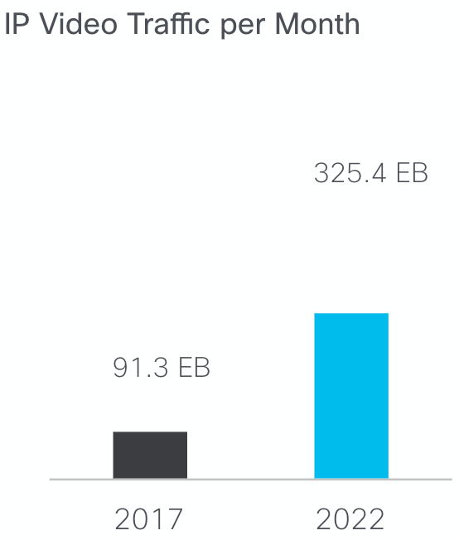
Larger Volume & Demand
According to Cisco [1]
3-fold increase in IP traffic over the 5 years (from 2017)
82% of all IP traffic is IP video traffic (in 2022)
7-fold increase in video surveillance traffic (2017 - 2022)
[1] Cisco Visual Networking Index: Forecast and Methodology, 2017–2022. White Paper. Cisco Systems, Inc., 26 Nov. 2018
Notes:
It is nice to reference such forecasts in an introduction section of your thesis (if it is related with multimedia).
Larger volume & larger demand begs for better quality (and also is a result of better quality being used).
This is a 4 fold growth in the plot on the right.
EB = exabytes = 1 million TB
There are much more forecasts so do not hesitate to take a look on your own.

Slide 7
Technology Enablers...
(D)WDM
BANDWIDTH
GbE
HFC
PLC, UWB Wi-Fi
FTTx, xDSL
home
AVAILABILITY OF BANDWIDTH – wireless
office
travel
SCALABLE VIDEO CODING – stream bit-rate
adaptation to the network
HDTV
SDTV
PC
Mobile TV
CACHING – Content Delivery Networks (CDNs)
Notes:
We went a long road to reach a point in which we are today.
I (i.e., JN) don’t know about you, but I prefer to consume content through a wireless network. In fact, I do not have a fixed internet connection in my home.
CDNs are a large part of what makes Netflix look good in comparison to competitors.

Slide 8
Technology Enabler –
Upload Bandwidth
New ways to use the media
Media Personalization
Injecting Advertisements
Citizens' Journalism
Internet Encyclopaedias
Photo Services
Notes:
We are not only the consumers, but also the producers.

Slide 9
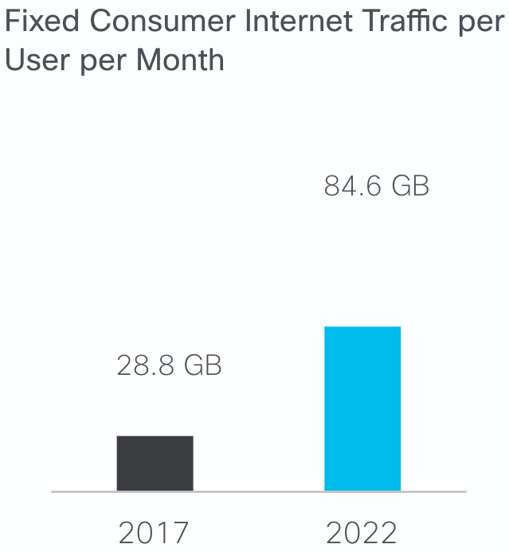
Upload Increase
According to Cisco [1]
the average internet user generated 84.6 GB of traffic per month (by 2022)
up 194% from 28.8 GB in 2017
[1] Cisco Visual Networking Index: Forecast and Methodology, 2017–2022. White Paper. Cisco Systems, Inc., 26 Nov. 2018

Slide 10
Quality of Service
bandwidth
DATA TRANSMISSION
VIDEO TRANSMISSION
VOICE TRANSMISSION
losses
delay
Notes:
Mówimy o opóźnieniu, przepustowości oraz stratach ruchu. Tu pokazujemy wymagania per-serwis.
QoS - possible to be objectively measured. I can measure a time, delay and number of lost packets.
Various transmissions are sensitive to various degrading factors:
Voice transmission - requires low bandwidth, but sensitive for the delay
Data transmission - may require high bandwidth, but can tolerate the delay
Video transmission - requires high bandwidth, is able to recover from losses, but does not tolerate the delays

Slide 11

Quality of Experience (QoE)
Quality of Service (QoS), not enough for service providers
Real challenge - Quality of Experience (QoE)
Global issue, significant trend in development of multimedia systems
For video: Video Quality Experts Group
Notes:
I know how many packets I have lost, but what does the end-user think about it? - the question many board members of Internet Provider companies asked

Slide 12

QoE by White Book of QUALINET Network
The QoE research topic is related to the “degree of contentment or annoyance of the user of the application or service. QoE results from the fulfillment of the user's expectations regarding the usability and/or satisfaction of the application or service in the light of current user preferences.”
Notes:
There is a newer definition from The QoE Book
QoS - objective
QoE - subjective
Current preferences and expectations are important phrases here.

Slide 13

QoE by The QoE Book
“Quality of Experience (QoE) is the degree of delight or annoyance of a person whose experiencing involves an application, service, or system. It results from the person’s evaluation of the fulfillment of his or her expectations and needs with respect to the utility and/or enjoyment in the light of the person’s context, personality and current state.”
Adapted from Möller, S., & Raake, A. (Eds.). (2014). Quality of Experience. https://doi.org/10.1007/978-3-319-02681-7

Slide 14
Aspects of Media Ecosystem
Content
Delivery
QoE
Usability and Interaction
Business Model
Notes:
QoE as a point of contact between all of those.
QoE has a significant impact

Slide 15
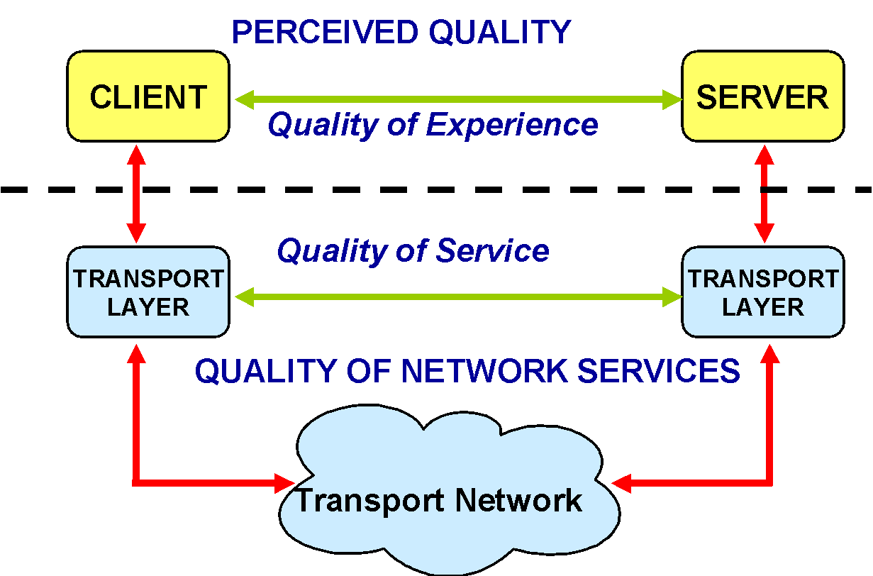
Quality of Service?
Quality of Experience?
Notes:
Vertical axis denotes a layer. At the top - (there should be) a user of the client & owner of the server.
QoS - countable and easier to measure.
QoE - difficult to measure, but better correlates to actual quality.

Slide 16
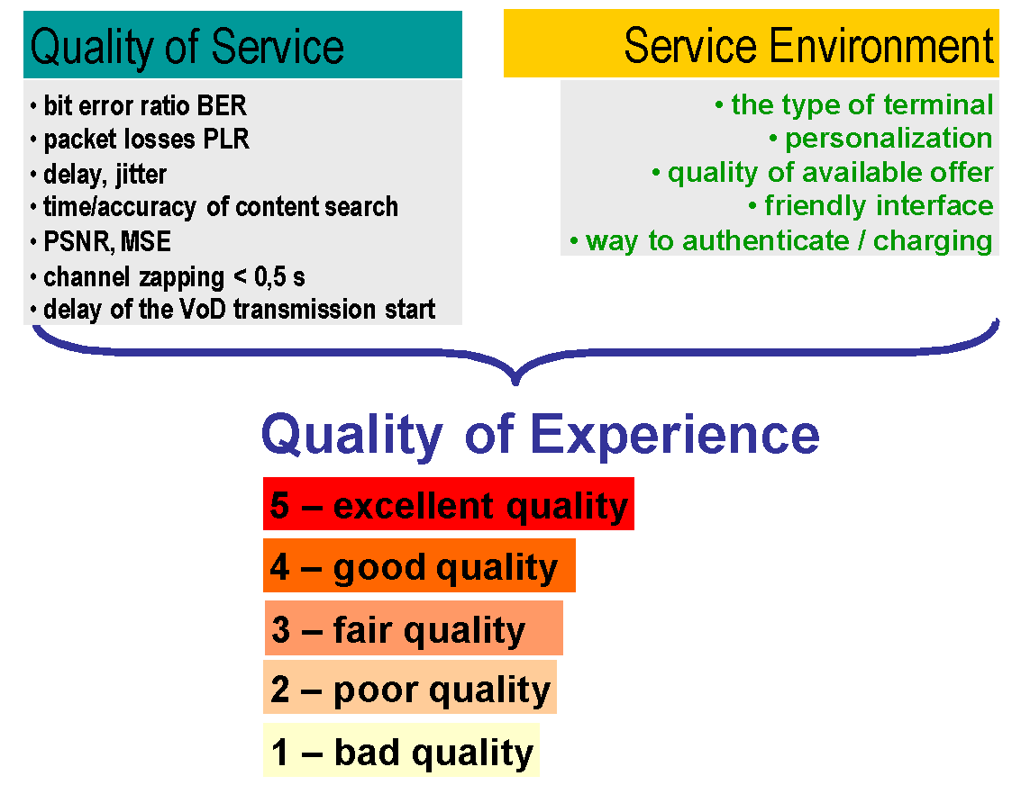
Quality of Experience
Notes:
QoE includes QoS

Slide 17
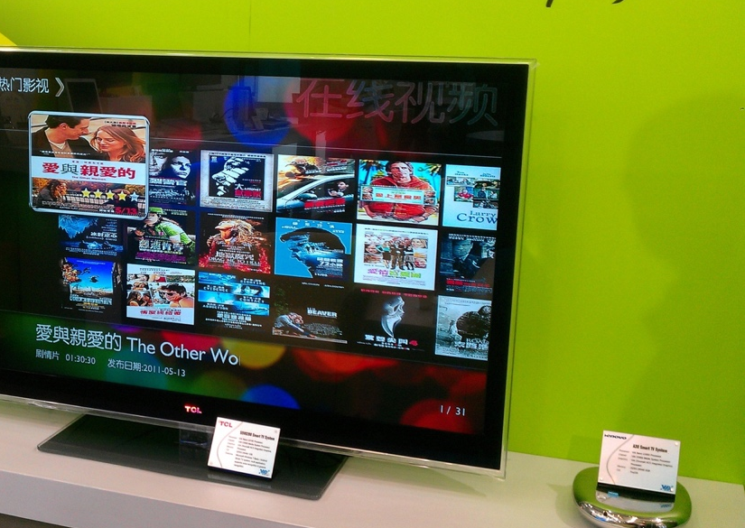
Multimedia Quality Problem
Over-The-Top (OTT) video streaming
Multimedia market competition
Quality-driven customer churn
What is far end quality?
By VIA Gallery from Hsintien, Taiwan – VIA QuadCore @ Computex 2011-Smart TV Video on Demand, CC BY 2.0, https://commons.wikimedia.org/w/index.php?curid=38934022
Notes:
The demand for quality is constantly rising. Whenever I can compare some old solution with the new one, the old is rated lower than before.

Slide 18
Subjective Methods of Measuring QoE

Slide 19


Quality of Experience (QoE)
The degree of delight or annoyance of a person
The person experiences an application, service, or system
The QoE results from the fulfillment of the person’s expectations and needs wrt utility and/or enjoyment
All that in the light of person’s context, personality and current state
Adapted from Möller, S., & Raake, A. (Eds.). (2014). Quality of Experience. https://doi.org/10.1007/978-3-319-02681-7
Notes:
wrt = with respect to
User-centric approach
Relative to the current user’s expectations
Strongly connected with the way we perceive the world

Slide 20
From Quality of Service (QoS) to Quality of Experience (QoE)
QoS
Quality model
QoE
Pixels
Calibration
What we know
What we build
What we want
Notes:
The next slide: so how do you get the calibration data?

Slide 21
Idea
Subjective scores (i.e. calibration data) = ground truth
Vary contents to measure the quality
Everything else should stay the same
Use the scores to improve your predictions about the quality (i.e., build a better-quality model)
Notes:
Subjective scores - so called ground truth (i.e., provided by direct observation and not coming from inference)
Controlled environment - get rid of, hopefully, all confounding factors.

Slide 22
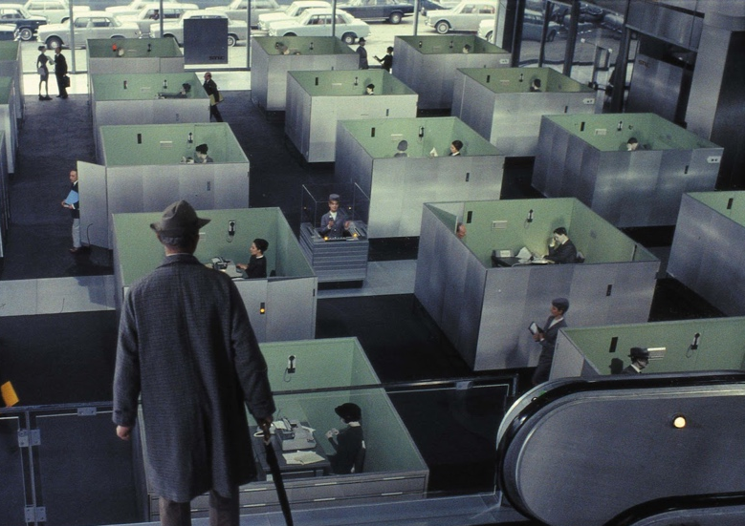
Obtaining Calibration Data
Perform a “subjective test”
Subjective scores as a result
Basically, subjective scores
Hundreds to thousands needed
Various content, quality, people, etc.
Homogeneous conditions
Notes:
Subjective Methods for Measuring QoE start here - must be done on 29/30 Nov

Slide 23

Building of AGH Institute of Telecommunications

Slide 24

QoE Laboratory - Outside

Slide 25
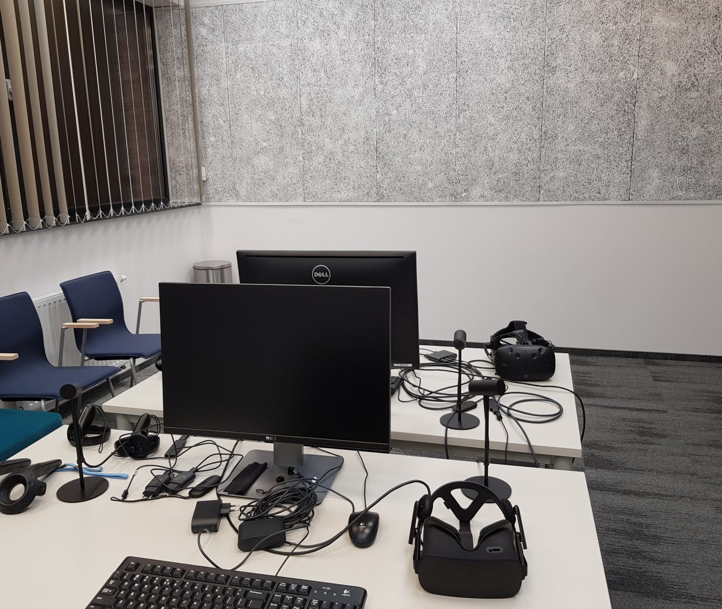
QoE Laboratory - Inside

Slide 26
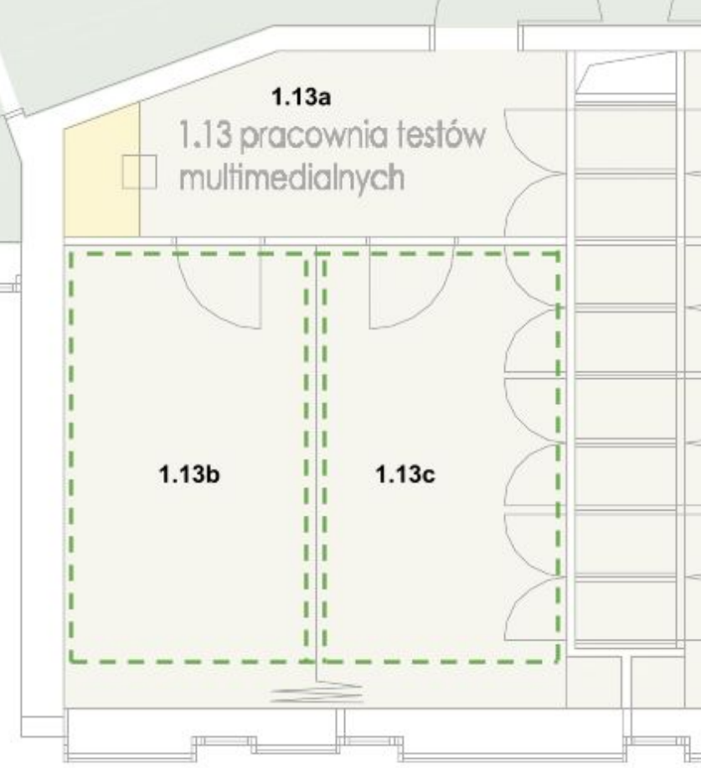
Laboratory of multimedia tests

Slide 27
Idea of Psychophysical Experiments (Subjective Tests)
User opinion = final score
Asking users about quality while using service - difficult or impossible
Subjective experiment - often best option to collect users' opinions
Controlling distortions
Controlling use case
Notes:
User opinion - so called ground truth (i.e. provide by direct observation and not coming from inference)
Controlled environment - get rid of, hopefully, all confounding factors.

Slide 28
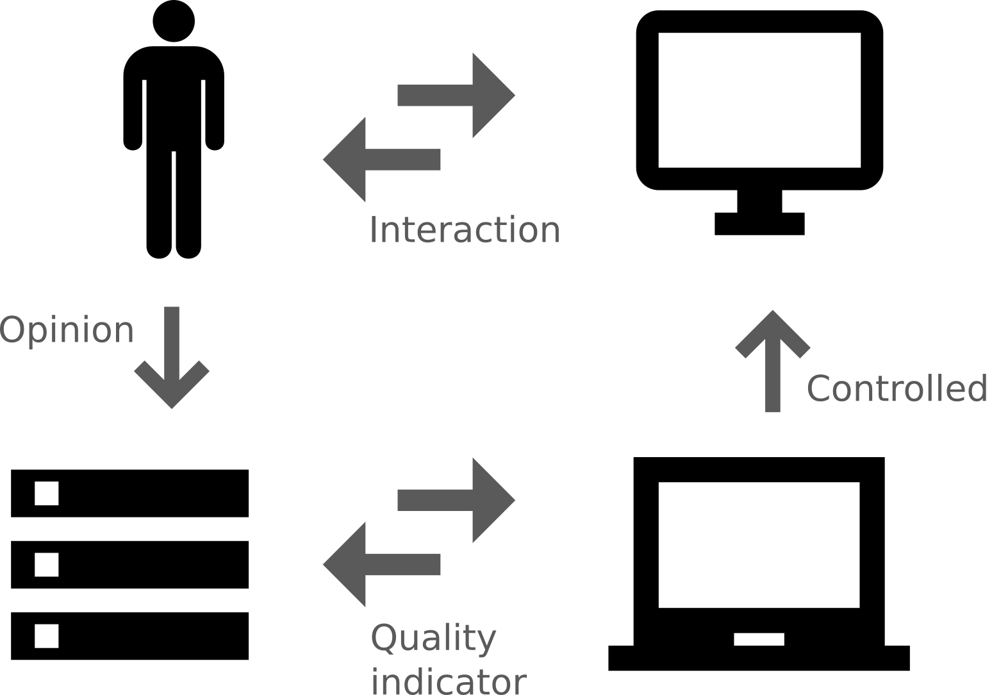
Practical Realisation of Subjective Experiment

Slide 29
Naming Conventions of Psychophysical Experiments (Subjective Tests)
Sources (SRC)
Hypothetical Reference Circuits (HRC)
Processed Video Sequences (PVS)
Mean Opinion Scores (MOS)
Notes:
Explain the terms

Slide 30


Content is Important
Different expectations from different contents
Examples:
Sport,
News,
Cartoon.
Try to accomodate for the whole scale of qualities
Images taken from the VQEG’s Report on the Validation of Video Quality Metrics for High Definition Video Content

Slide 31


Testers are Important
Different expectations depending on a social group
Examples:
age groups,
ethnic groups,
level of advancement groups
Notes:
The level of advancement - one can be a naive user or an expert.

Slide 32

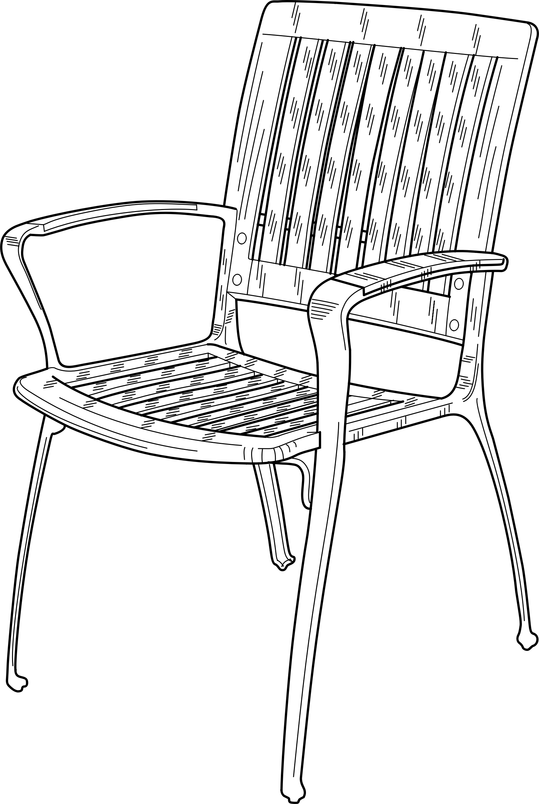
Environment is Important
Lighting conditions
Display size
Distance from the display
Is tester sitting on a chair or a sofa?
Is there anything that can distract the tester?
Notes:
Those are one of the most important factors defining whether your test can be compared with any other test.
We have a sofa in our QoE laboratory (the B9 building, 1st floor). It is good for having internal meetings as well as for testing!

Slide 33

Training is Important
We want to have the data of good quality
The tester must know how to use a testing interface
Notes:
quality data - garbage in, garbage out if the tester does not know what one is doing

Slide 34
Why do We Care?
We want repeatable results (that can be compared among many laboratories)

Slide 35
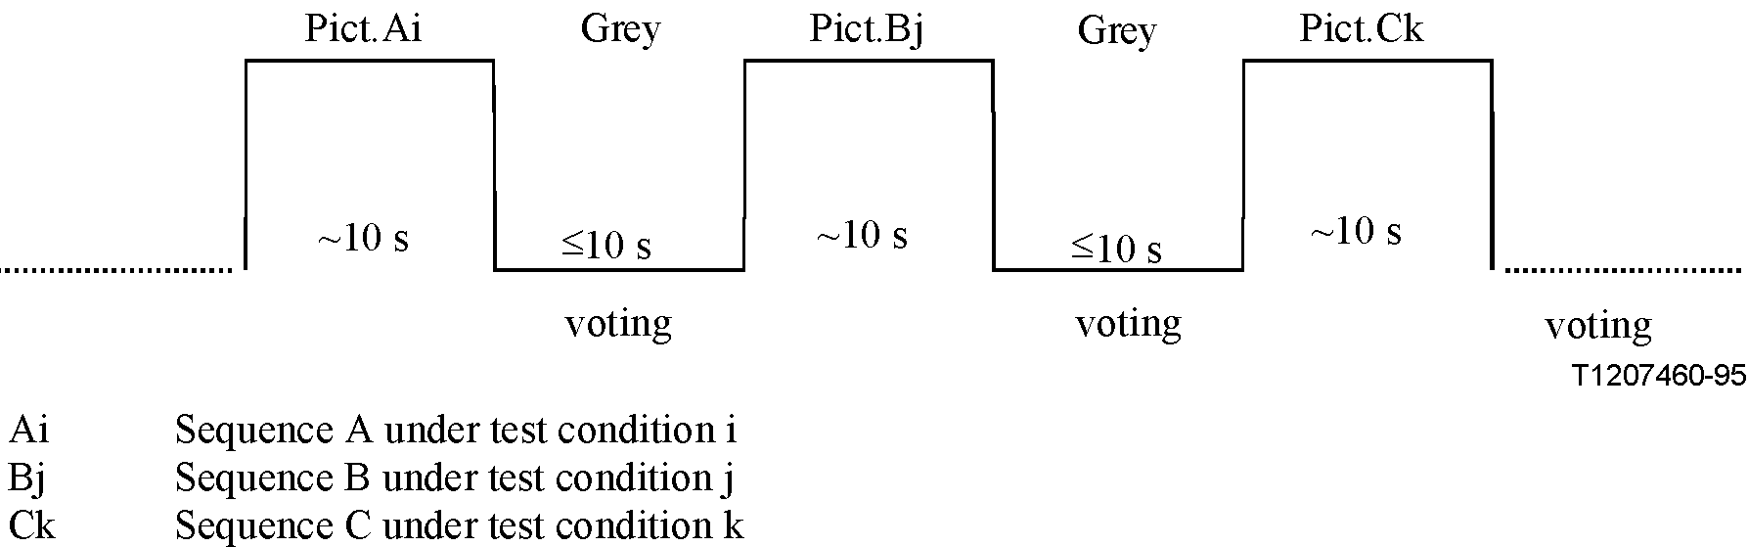
Absolute Category Rating
Training & actual experiment sessions
Each sequence rated individually (ACR scale)
Labels on scale: bad, poor, fair, good, excellent
Translated to values 1-5 when calculating MOS
Notes:
PVSs rated one-by-one; no explicit comparisons; labelled, ordinal scale

Slide 36
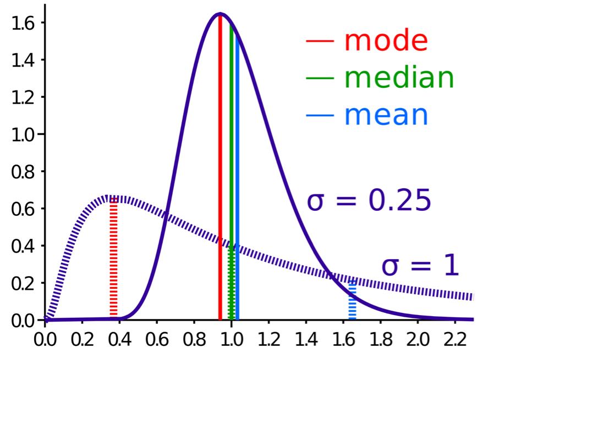
Analysis of Results – Average
Average (mean) score for each:
Subject
PVS
HRC
Mode and median less common
By Cmglee – Own work, CC BY-SA 3.0, https://commons.wikimedia.org/w/index.php?curid=15147460
Notes:
Notice how the mean differs for distributions having the same median.

Slide 37
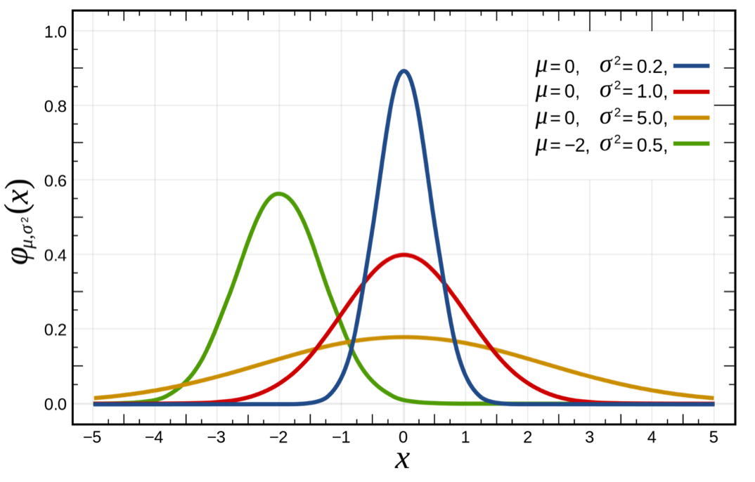
Analysis of Results – Normal Distribution
Each subject – different rating patterns
Some subjects not using entire scale
But histogram to look normally distributed

Slide 38

Analysis of Results – Student’s t-Test
t-Test – statistical hypothesis test
Used to determine if two sets of data significantly different from each other
Most applied when normal distribution
Testing e.g., if perception threshold quality distinguishable from SRC quality

Slide 39
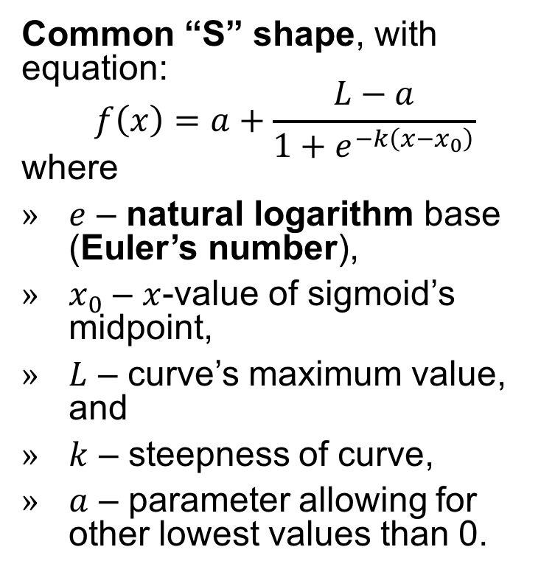
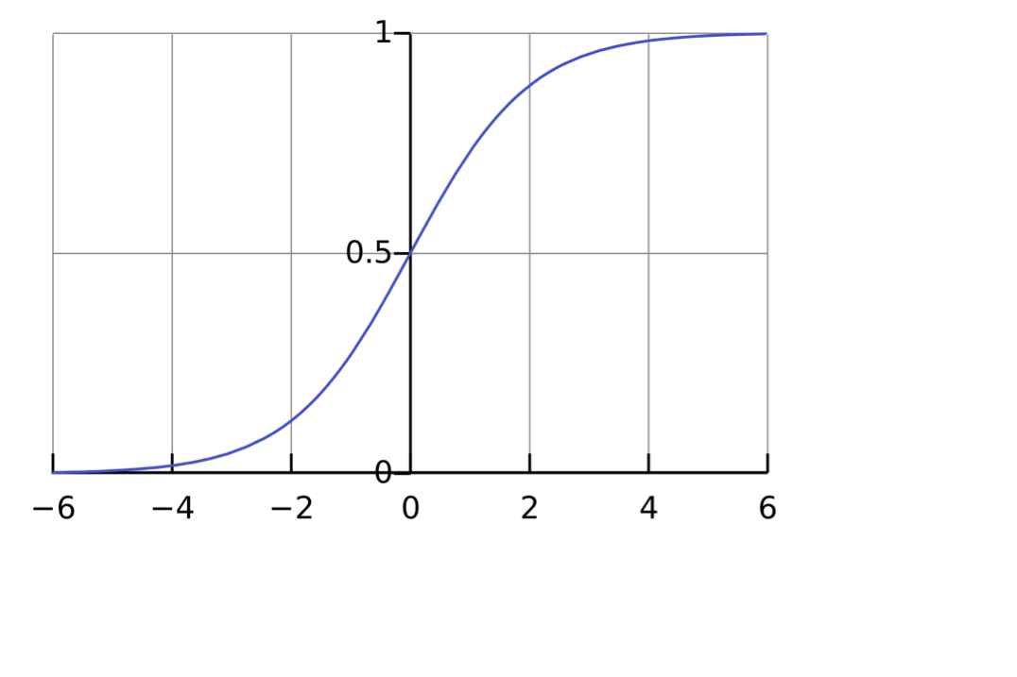
Analysis of Results – Modelling using Sigmoid (Logistic) Function
By Qef (talk) – Created from scratch with gnuplot, Public Domain, https://commons.wikimedia.org/w/index.php?curid=4310325
Notes:
It is most often used to weigh the importance of some phenomena (e.g. brightness or contrast).

Slide 40
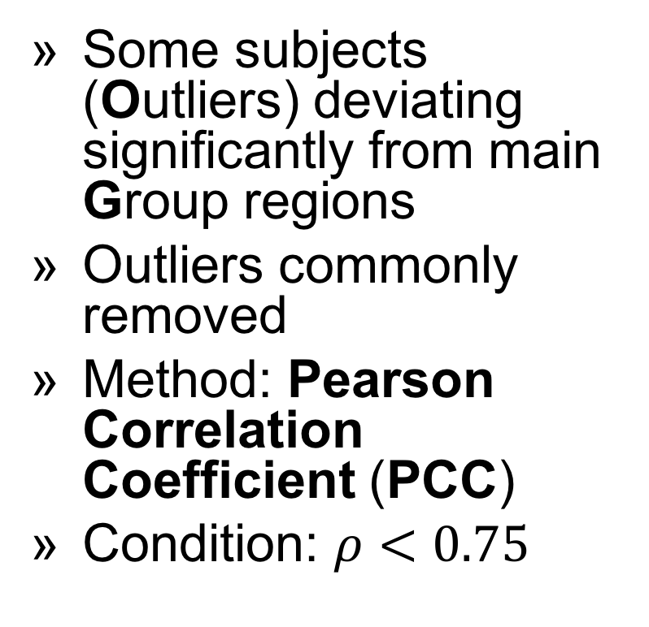
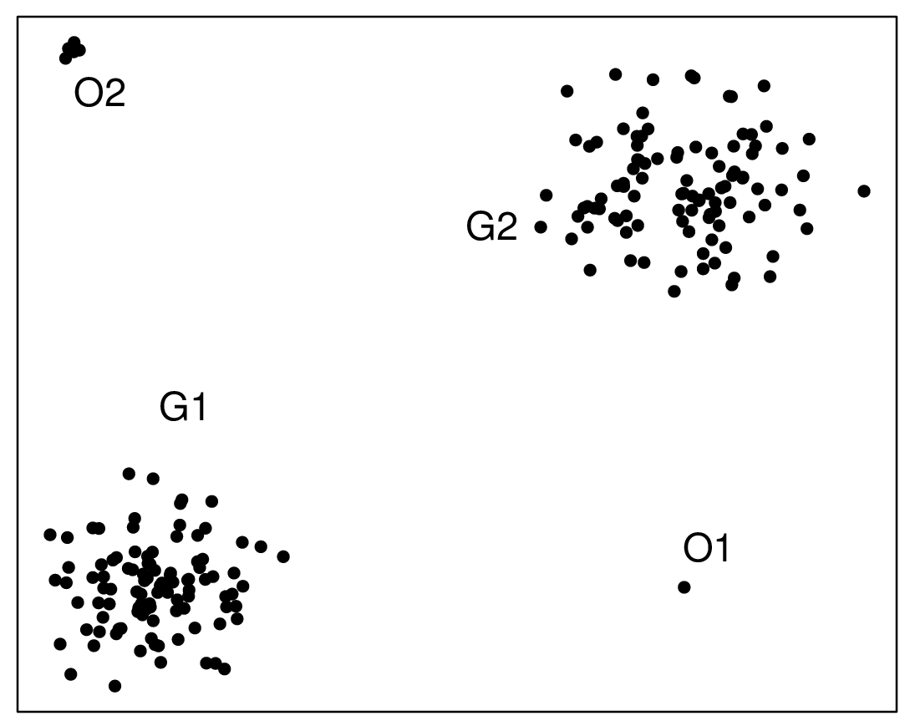
Analysis of Results – Outliers
By Osrecki – Own work, CC BY-SA 4.0, https://commons.wikimedia.org/w/index.php?curid=48650484

Slide 41
Dark Side
Subjects scoring whole experiment not just single sequence
Correct experiment needing careful preparation
In general asking people about anything – tricky
Obtained conclusions to consider experiment limitations
Notes:
Problem of comparing results from different experiments

Slide 42
Objective Methods for Measuring QoE

Slide 43
From QoS to QoE
QoS
Quality model
QoE
Pixels
Calibration
What we know
What we build
What we want
Notes:
Slide from the previous presentation
Quality model - this is the objective method measuring the QoE

Slide 44
What are Those?
Algorithms using objectively measurable input and providing objectively measurable output
For example: “give me a video and I will tell you what an average end-user thinks about its quality”
You want to replace a human with an algorithm

Slide 45
Why Objective Methods?
Objective - “based on real facts and not influenced by personal beliefs or feelings” (from Cambridge Dictionary)
Cheaper
CPUs are much faster than humans (if it comes to digital images processing)
Scalable
Assessing the quality of multiple sources
Notes:
It is safer to build a business based on something objective.
Cheaper - assessing the quality in non-objective way means contacting your end-users (how many do you have?)
Scalable - currently, in TV head-ends, there are people just sitting and watching everything that goes on-air

Slide 46
Classification
Full Reference
No Reference
Full access to the original content
Computationally intensive
Good for content producers (and modifiers)
No access to the original content
Faster than FR methods
Scalable
Notes:
No Reference (NR):
-> scalable: NR probe can be attached at any point there is access to a video signal
There are also Reduced Reference (RR) and mixed methods, but they are not so popular.

Slide 47
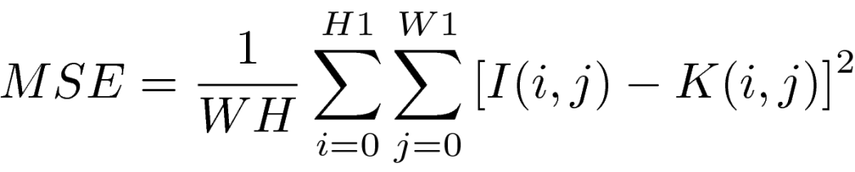
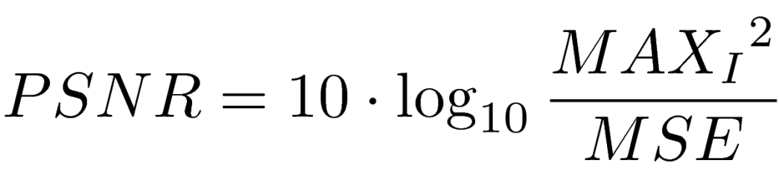
PSNR
Examples
The most popular
Based on Mean Squared Error (MSE) metric
Used in Shot Boundary Detection (SBD)
For details, see here
Full Reference
Notes:
I gave here equations without deep explanation. For details please refer to the laboratory instruction.

Slide 48
SSIM (Structural Similarity Index Measure)
Developed by Wang et al., 2004 – improves upon PSNR and MSE
Measures structural similarity between reference and distorted images
Compares luminance, contrast, and structure components
Output range: -1 to 1 (typically 0-1); higher = better quality
Better correlation with human visual perception than PSNR
Widely used for image and video quality assessment
Full Reference

Slide 49

VMAF
Examples
Perceptual video quality assessment based on multi-method fusion
State-of-the-art
Created by Netflix, Inc.
Click the Octocat to go to its repository
Full Reference
Notes:
I didn’t use Netflix’s logo, because it is not legal to do so without their prior consent. The story is different if it comes to Octocat that links to GitHub.

Slide 50

Implementation of Key Performance Indicators (KPIs) for Quality Measurement
No Reference
Notes:
Objective measurement of QoE starts here - present it on Dec, 6 2018
Not only implementation, but also the general description
Special type of quality - subjectively perceived quality

Slide 51

General Information
Algorithmic approach to visual quality assessment:
repeatable
easy to manipulate
countable
implementable
Notes:
Repeatable: more stable than asking people about the quality
Easy to manipulate: possible to map it to other measures, one may look for correlation between various phenomena, in general, application of mathematics is possible!
Countable: good medium for comparison of various visual materials
Implementable: can be (and was) transferred to both software and hardware solutions

Slide 52

General Information
Measurement targeting many artifact sources:
capturing
processing
transmission
display
Notes:
capturing: optics non-ideality
processing: mainly compression and rescaling
transmission: lossy medium
display: low dynamic range, smaller colour gamut
targeting specific distortions should give higher accuracy

Slide 53

General Information
Results reflecting subjectively perceived quality:
correlation with human perception of visual artifacts
signal-based approach (so called No-Reference approach)
Notes:
KPIs - objective quality measure (any numerical value),
People’s opinion - subjective quality measure (usually Mean Opinion Score)
Non-trivial goal - in practice, one has to run subjective tests
If human perception is the most important, then let’s focus on visual signal and not compression, transmission parameters and so on

Slide 54
No-Reference Approach
Opposite to Full-Reference approach
Easily applicable to many scenarios:
No-Reference probe can be attached at any point of content delivery chain
no need of source material
access to visual content as the only one requirement
Notes:
Full-Reference is a classical approach - take each pixel from unmodified image and compare it with associated pixel in modified image
source material - unmodified, original, high-quality visual content (no compression, no lossy transmission)
One does not need to have knowledge about transmission, compression and display parameters

Slide 55
No-Reference Approach
Non-trivial:
based on Human Visual System (HVS) response to visual artifacts
no information about compression and transmission parameters
no direct way to compare with source material
Notes:
Not everyone has the same sensitivity for visual artifacts
It is not possible to apply simple pixel-to-pixel algorithm comparing modified and unmodified visual material

Slide 56
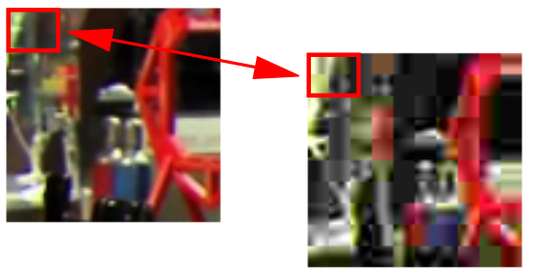
Other Approaches
Full-Reference:
applicable when source material is accessible
usually computationally intensive
good for content producers/modifiers
Notes:
In practice, this approach achieves higher correlation with subjectively perceived quality
Standardised approach used by many important players (e.g., Netflix)
Classical, well-defined

Slide 57
Other Approaches
Reduced-Reference
only some parameters about the source material and its processing are available
Bitstream-based
no need to access visual signal
ongoing development by standardisation parties
Notes:
Bitstream-based:
one wants to say as much as possible about the visual content by looking on the transport layer (but not only)
can be applied at many points of delivery chain
can be used with encrypted signal
modular build: if only transport level - transport level measurements, if more - more

Slide 58
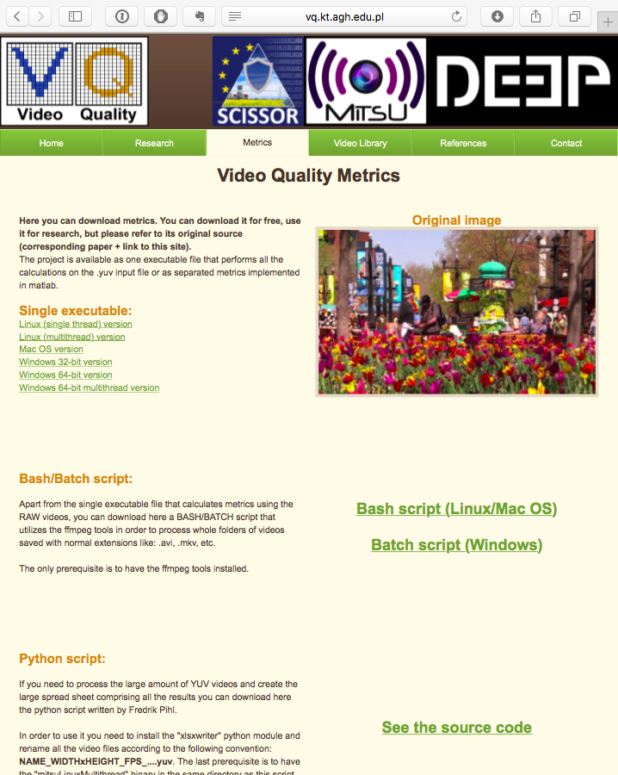
Our Implementation
15 Video Quality Indicators (VQIs)
Implemented in C
Binary executables freely available online at: http://qoe.agh.edu.pl
Source code available for research upon request
Notes:
VQIs is just our name for KPIs
C implementation makes it easy to port the algorithms to various platforms
Tested quite well (e.g., by licensing parties)

Slide 59
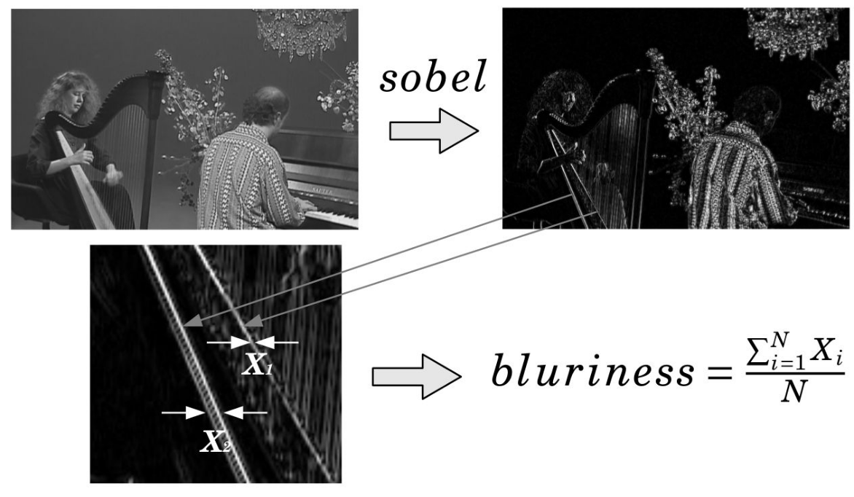
Example: Blur VQI
Notes:
Execution flow:
Read Y channel from YUV image,
Find edges using Sobel filter,
Measure width of edges
Only a subset of existing edges are chosen (based on dynamically calculated threshold value derived from standard deviation for a given macro block)
Result is proportional to mean width of edges

Slide 60
Quality of Experience and Its Relationship with Usability

Slide 61
Definitions
Usability (ISO 9241-11): effectiveness, efficiency, satisfaction in a context of use
QoE: delight/annoyance from service/application/system
Common element: user satisfaction

Slide 62
Key Differences
QoE → focuses on media/service quality
Usability → focuses on interaction design
QoE is content- and network-driven; Usability is task- and interface-driven

Slide 63
Intersections
Both influence overall User Experience (UX)
Example: A video streaming app may have excellent QoE (smooth playback) but poor usability (confusing navigation) → dissatisfaction

Slide 64
Takeaway
QoE and usability are complementary
Joint evaluation is crucial for holistic understanding of UX

